Slide 1
AstraZeneca AI Challenge
Team Name : CodingBeginner
Name : Rohith Srinivaas M
(SHA008208)
IIT Madras

Slide 2
JigSaw Unintended Bias in Toxicity Classification
Objective : Rate the toxicity in a given data instance
Target prediction is a fraction denoting the toxicity level in the comment thereby classifying it as a positive or negative comment.
Subtype attributes for toxicity:
Severe_toxicity
Obscene
Threat
Insult
Identity_attack
sexual_explicit

Slide 3
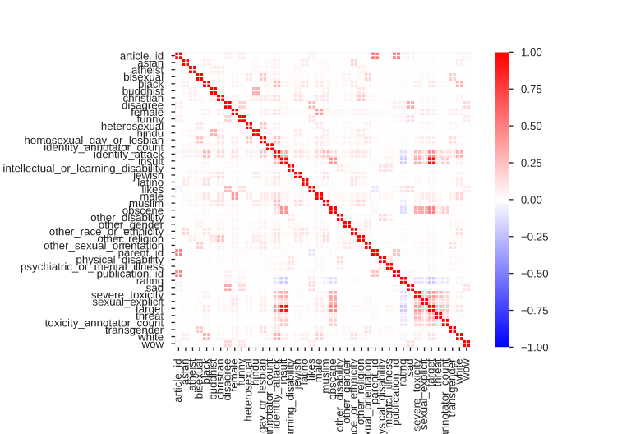
Exploratory Data Analysis ( EDA )
Pandas profiler was used for quick EDA of the dataset.
Important observations are given below:
target is highly correlated with insult with ρ = 0.928206624.
The overlap between white and black identity comments is high.
A large number of comments about the Jewish identity is toxic towards the Muslim identity

Slide 4
Approaches
Using Logistic Regression
Using ELI5 to understand bias.
Using textCNN
Using LIME to understand bias.

Slide 5
Metrics
SubGroup AUC :
only to the examples that mention the specific identity subgroup
A low value in this metric means the model does a poor job of distinguishing between toxic and non-toxic comments that mention the identity.
BPSN (Background Positive, Subgroup Negative) AUC :
To the non-toxic examples that mention the identity and the toxic examples that do not
A low value in this metric means that the model confuses non-toxic examples that mention the identity with toxic examples that do not, likely meaning that the model predicts higher toxicity scores than it should for non-toxic examples mentioning the identity.
Reference : Nuanced Metrics for Measuring Unintended Bias with Real Data for Text Classification

Slide 6
Metrics
BNSP (Background Negative, Subgroup Positive) AUC :
To the toxic examples that mention the identity and the non-toxic examples that do not.
A low value here means that the model confuses toxic examples that mention the identity with non-toxic examples that do not, likely meaning that the model predicts lower toxicity scores than it should for toxic examples mentioning the identity.
Reference : Nuanced Metrics for Measuring Unintended Bias with Real Data for Text Classification

Slide 7
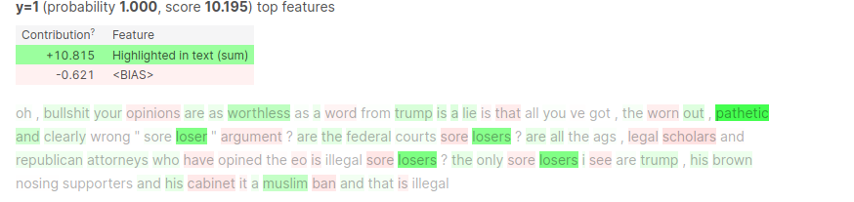
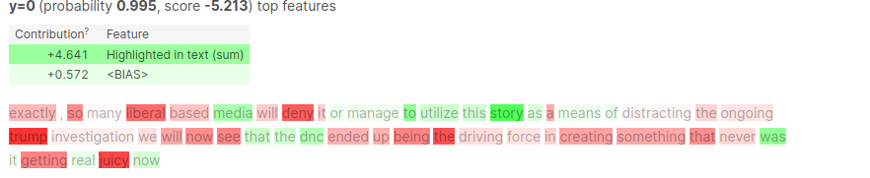
Results and Discussion
Using Logistic Regression
Used TweetTokenizer from nltk package with Tfidvectorizer to get the word-vector.
Performed Logistic Regression with the obtained word-vector with class = 1 for target >= 0.5 and vice versa
Used ELI5 for model interpretation:

Slide 8
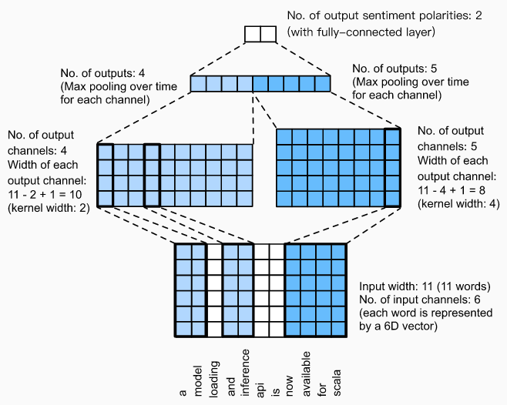
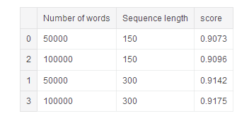
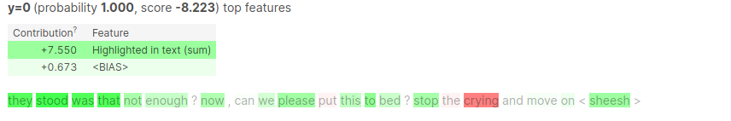
Results and Discussion
Using TextCNN
One of the important hyperparameters in textCNN is the sequence length.

Slide 9
Improvements
Using pretrained Word Embeddings like BERT, FastText, Glove to predict the toxicity and then use weighted sum of these vectors ( with subgroup bias ) to get the meta word-vector with minimum bias which can be used for further classification.

Slide 10
Thank You

